Slide 1
Hardware Design
Vivado 2014.4 with SDK
Single ARM core processing system
GPIO in PL for LEDs and switches
DMA controller to feed data to FFT
FFT implemented in PL

Slide 2
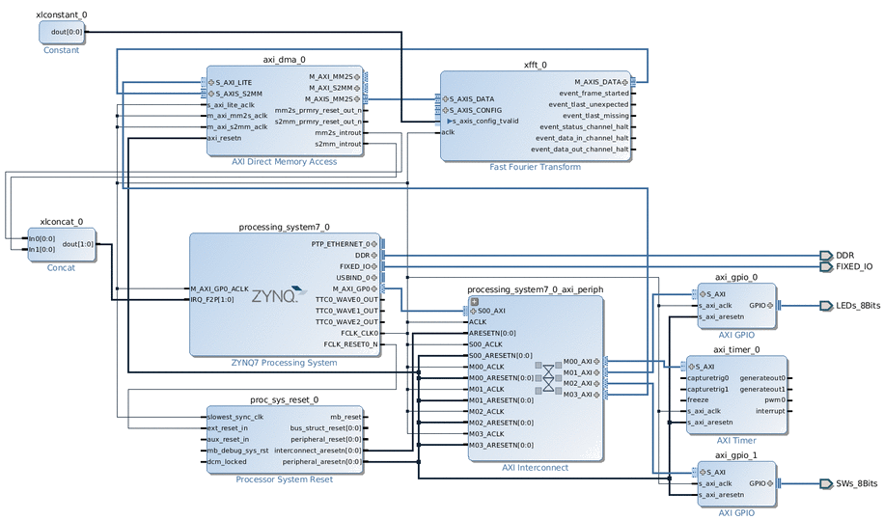
Hardware Design
Notes:
FFT Implemented in hardware but not in software
Single ARM core
GPIO support for switches and LEDs

Slide 3
FPGA Software
FreeRTOS v7.0.2
lwip v1.4.0
Based of lwip demo (XAPP1026)
Allows TCP connections from client program

Slide 4
Client Program
Written in Python
Retrieves metadata from XML
Send metadata and 64 IQ pairs

Slide 5
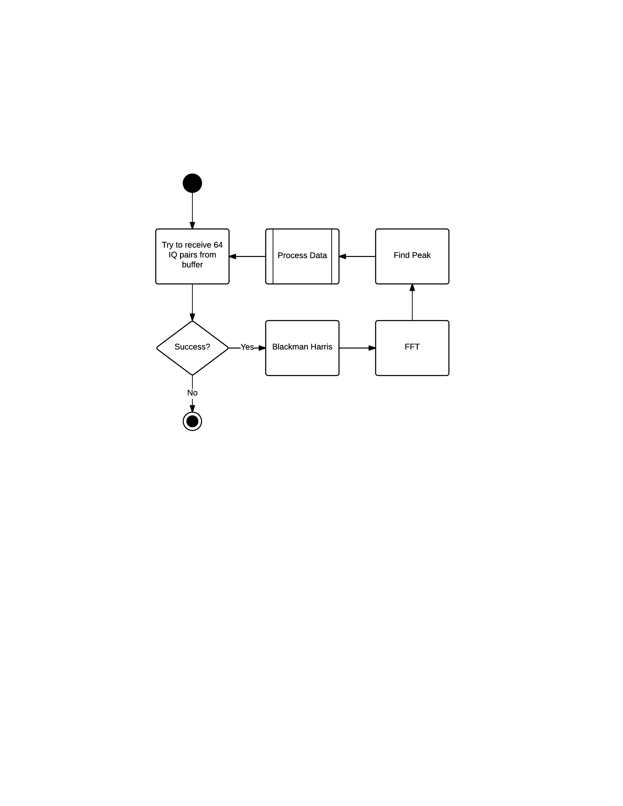
Main Program Loop

Slide 6
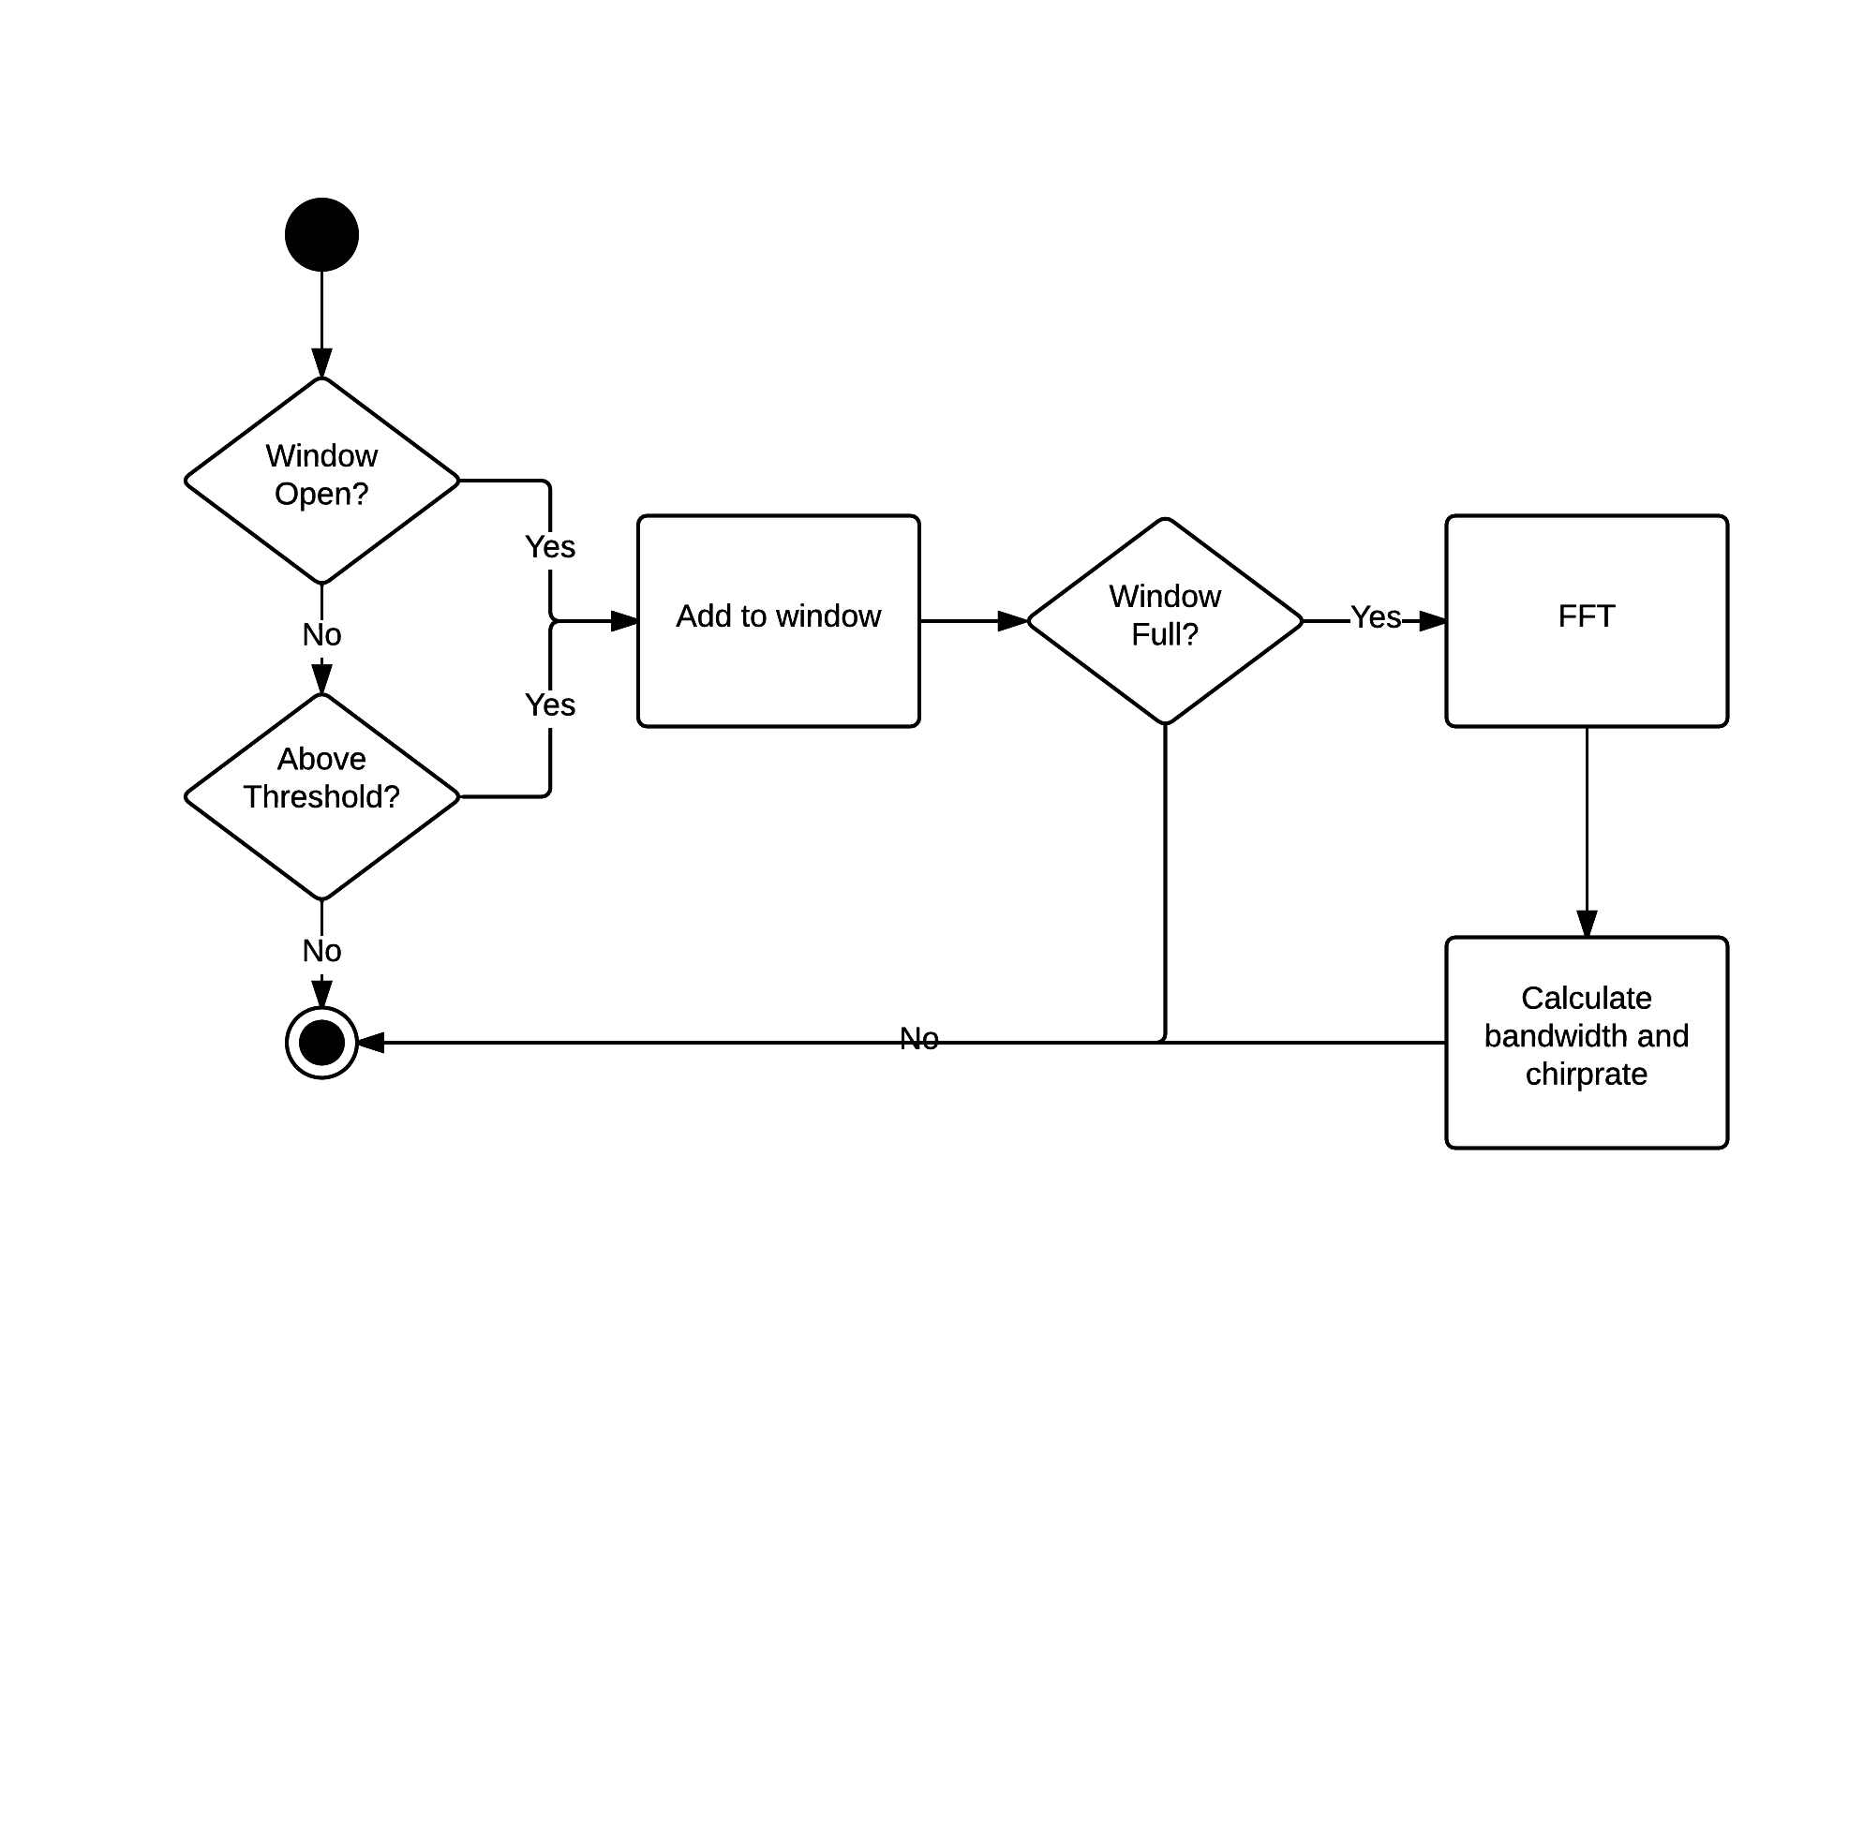
Window Processing

